Slide 1

“AI-TRANSIT ALERTS”
PRESENTED BY
APEKSHA S [1MP23AD003]
HIMA GOWDA N [1MP23AD016]
RAMYA R [1MP23AD042]
SOHAN M [1MP22AD048]
UNDER THE GUIDANCE OF
Mamatha V Jadhav
Assistant Professor
Dept. Of AI&DS
BGSCET

Slide 2

OVERVIEW
Abstract
Introduction
Literature Survey
Problem Statement
Objectives
Requirement Specification
Block Diagram
Expected Outcomes
Bibliography

Slide 3
ABSTRACT:
This project uses AI-powered cameras, ticketing, and GPS data to provide real-time passenger counts in public transport, generating instant alerts for both passengers and authorities. By analyzing crowd data, it enables smarter route optimization and vehicle management, improving efficiency. The solution aims to enhance safety, comfort, and urban travel experience through intelligent monitoring and proactive decision-making.

Slide 4
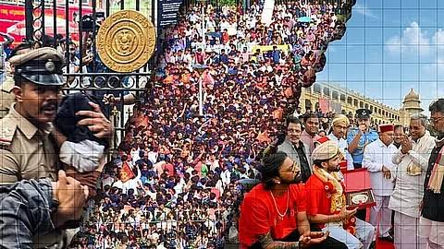
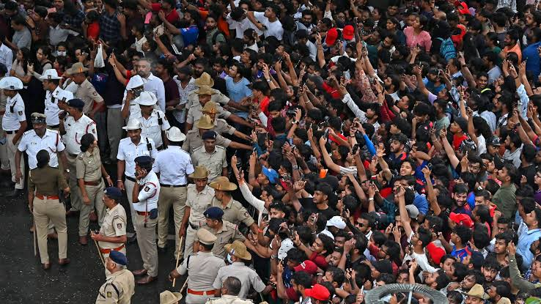
INTRODUCTION
SIGNIFICANCE
Major crowd disasters like the RCB Paradigm stampede highlighted the dangers of overcrowding in public transport areas, resulting in tragic loss of life.
Similarly, incidents such as the Mumbai Elphinstone railway bridge stampede (2017) have exposed the risks associated with unmanaged passenger crowds in busy transit spaces.

Slide 5
INTRODUCTION
❖ Need for Solution: To prevent such tragedies and enhance safety for commuters, there is an urgent need for smarter crowd monitoring in public transport systems.
❖ Our Project: This project proposes an intelligent crowd monitoring system using IP Webcam video feeds, ticketing data (Kaggle), and GPS integration to provide real-time crowd analysis, automatic alerts, and effective management tools for safer and more efficient public transport.

Slide 6
Literature Survey
References | Author | Concepts | Objectives | Demerits
People Counting Using IP Webcam Video Streaming | [Author(s) TBD] | Uses IP Webcam (an Android app) to stream real-time video for people counting and crowd analysis in public transport areas | Provide real-time crowd density estimation using mobile-based video feeds. | Dependent on mobile device placement, network stability, and video qualitY
Crowd Monitoring in Public Transport using GPS and Ticket Data | [Author(s) TBD] | Integrates GPS location data with ticketing information to estimate passenger counts and vehicle occupancy | Improve accuracy of crowd estimation by combining multiple data sources for real-time updates | Data synchronization and privacy concerns with ticketing data.

Slide 7
Continued..
References | Author | Concepts | Objectives | Demerits
AI-based Video Analytics for Passenger Crowd Monitoring | Zhu et al | Combines computer vision and sensor data for crowd analytics using YOLO and tracking algorithms. | Provide effective crowd safety alerts and passenger flow management in transit stations | Computational complexity and dependency on high-quality video input
Smart Public Transport Crowd Estimation Using Multi-source Data | Deepthi VS et al. | Utilizes IoT sensors, GPS, ticketing data, and AI models for holistic crowd and occupancy monitoring. | Deliver integrated, real-time passenger monitoring to optimize transport operations and safety. | Hardware costs and maintaining data integration pipelines

Slide 8
PROBLEM STATEMENT
Addressing the Problem :
Public transport overcrowding causes discomfort, delays, and safety risks.
Without real-time crowd info, passengers and authorities cannot avoid or manage overcrowding effectively.
Current solutions are limited, making the problem worse during peak hours and special events.

Slide 9
Why It Is Important ???
Real-time crowd monitoring and alerts improve safety and comfort, help authorities manage transport better, and encourage more people to use public transport, reducing traffic and pollution.
Better crowd management leads to smoother operations, higher passenger satisfaction, and supports sustainable urban mobility.

Slide 10
Objectives
Develop a real-time smart system that monitors crowd levels using AI cameras, ticketing data, and GPS tracking.
Provide accurate live passenger counts and crowd density information to minimize wait times and prevent overcrowding.
Send timely alerts to passengers and authorities about overcrowded vehicles to improve safety and comfort.

Slide 11
Requirement Specification
Hardware/Data Source Requirements:
Publicly available video datasets and IP Webcam streams for crowd analysis (e.g., bus/train station footage or similar).
Ticketing datasets sourced from platforms like Kaggle for passenger count estimation.
GPS trajectory data from open datasets to analyze vehicle movement and crowd location.
Software/Algorithm Requirements:
IP Webcam as the primary tool for real-time video capturing and crowd counting in transport environments.
Data integration scripts to combine video (IP Webcam), ticket, and GPS data for comprehensive crowd analysis.
Simple alert/visualization modules (Python, dashboard, or webapp) for displaying real-time crowd levels and sending notifications.

Slide 12
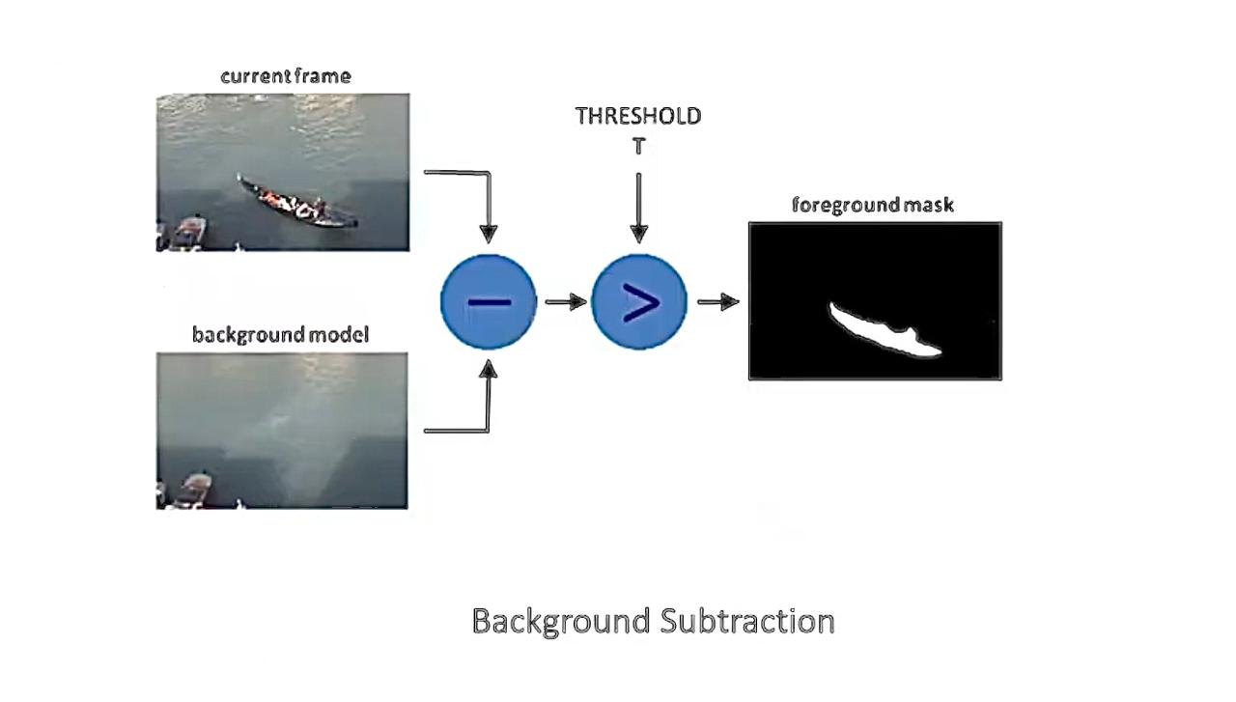

SYSTEM DESIGN

Slide 13
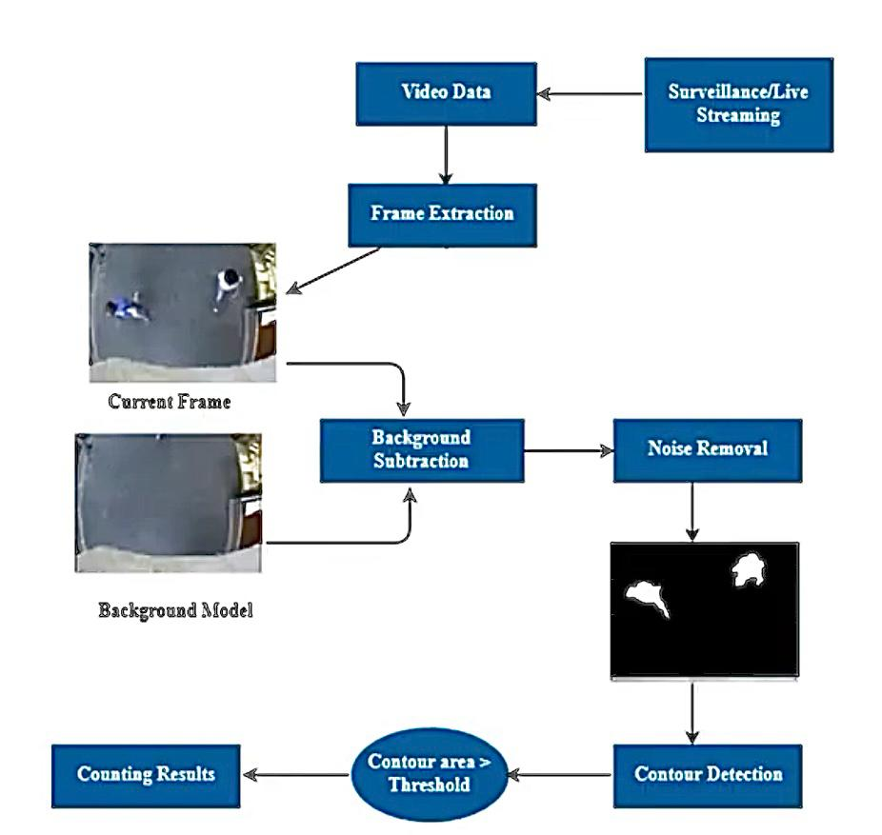

Slide 14
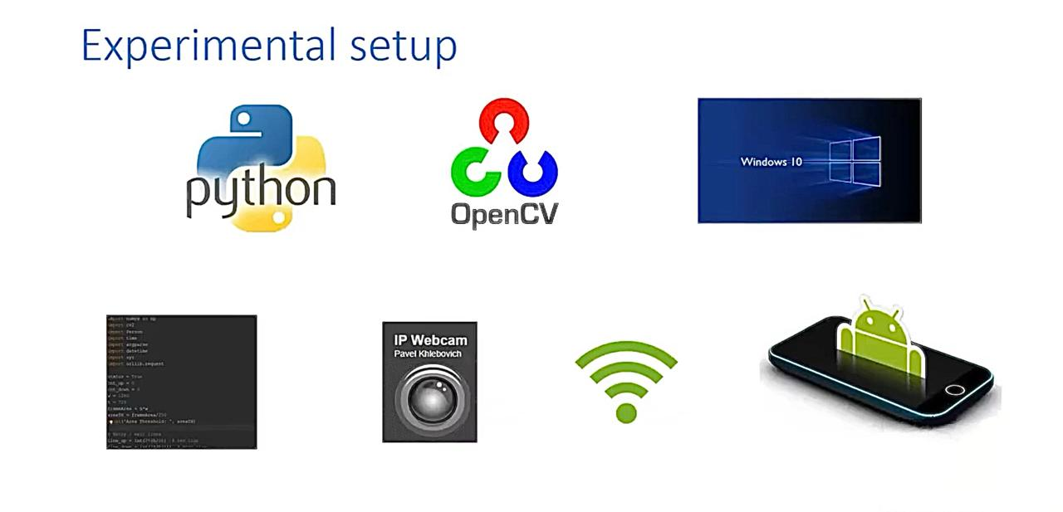

Slide 15
EXPECTED OUTCOME
Live dashboard displaying real-time crowd levels for buses and trains.
Automatic alerts sent promptly to transport managers and passengers upon overcrowding detection.
Enhanced travel safety and comfort with better decision-making support for authorities and commuters.
More efficient route and fleet management through timely deployment of additional vehicles when required.

Slide 16
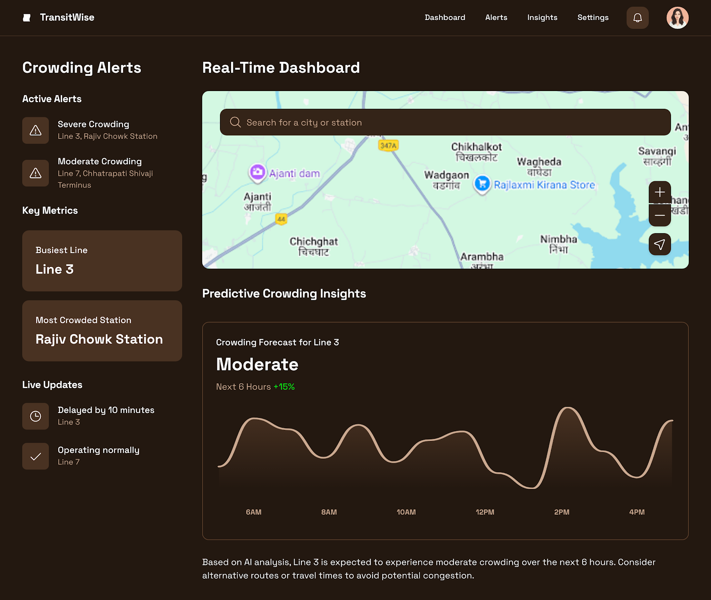
RESULT:

Slide 17
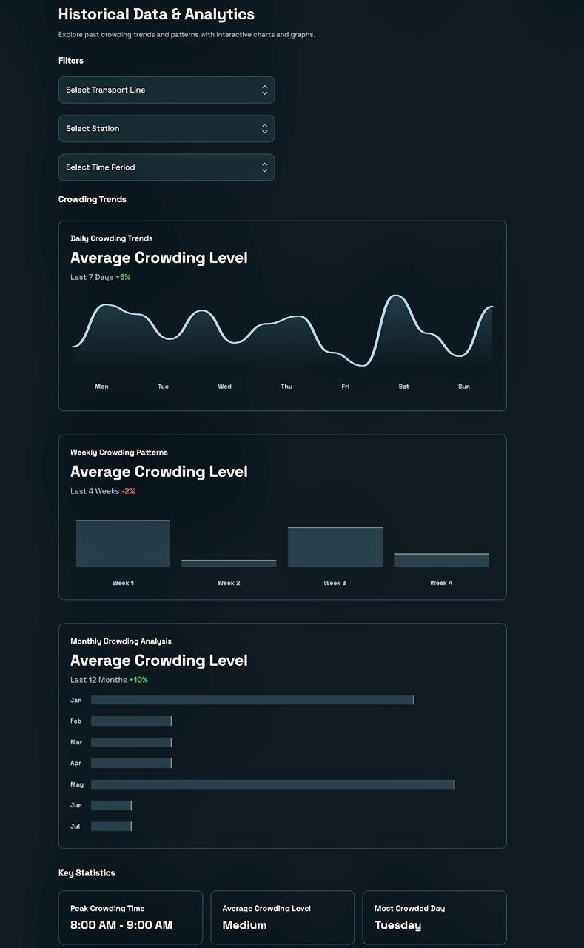
RESULT:

Slide 18
Advantages:
Provides real-time crowd monitoring to prevent overcrowding and enhance passenger safety.
Combines data from video, ticketing, and GPS for accurate crowd estimation and better transport management.
Sends automatic alerts to commuters and authorities, improving communication and response times
Limitations:
Dependent on stable internet connectivity for continuous video streaming and data updates.
Accuracy influenced by camera placement and quality of IP Webcam video feed.
Integration of multiple data sources can be complex and may face privacy challenges.
Applications:
Monitoring passenger density in public buses, trains, and metro stations.
Providing real-time alerts and updates to passengers and transport authorities.
Assisting in route optimization and fleet management during peak or emergency situations.

Slide 19
Bibliography
Redmon, J., Farhadi, A., “YOLOv3: An Incremental Improvement,” arXiv, 2018.
2. Ishwari Sidwadkar et al., “People Counting, Capturing Image Using YOLO Deep Learning Algorithm,” Journal of Engineering Research, 2024.
3. Deepthi VS et al., “Smart Public Transport Crowd Estimation Using Multi-source Data,” International Journal of Innovative Research, 2022.
4. Kaggle Datasets: Public transport ticketing and passenger count data, Kaggle, https://www.kaggle.com/.

Slide 20
THANK YOU

